Slide 1
ESTATE PLANNING MEETS FAMILY LAW
Presented by Glen Eichelberger and Amy Allen

Slide 2
Top Five Areas of Overlap
The Top Five:
Marital Agreements
Estate Planning Documents and Divorce
Trust Distribution Provisions and Income Characterization
“Descendants” & Modern Concepts of Family
Miscellaneous Issues Involving Entities

Slide 3
1. Marital Agreements

Slide 4
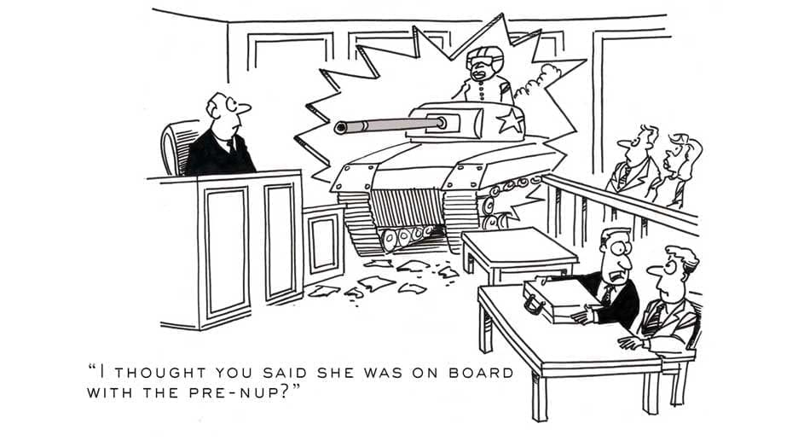

Slide 5
Observations of an Estate Planner Who Has Partners Who are Family Lawyers
Family lawyers like agreements that keep all property separate. But not all couples want a community property-less marriage, esp. younger couples from families of affluence.
Young couples may feel they need to build something “together” to have a normal marriage
Lack of some community property could put less wealthy spouse, esp. if non-working, at greater risk
So, many times we need to embrace some community property in such a premarital to make it palatable
Estate planners may focus on negotiating distributions in the event of the death of one spouse (esp. the “moneyed” spouse); family lawyers rarely focus (at least on death).
I have learned that the most typical family lawyer approach is to agree to NO mandatory provisions in the event of the death of one of the spouses (that is, that either is free to do as they please in their estate plan).

Slide 6
Observations of an Estate Planner Who Now Has Partners Who are Family Lawyers
Family lawyers focus on details which could lead to future challenges of enforceability which estate planners may or may not focus enough on.
Clear express waivers of right to further disclosure executed before the marital agreement and as a separate document
Only 2 methods to challenge under Tex. Fam. Code §4.006:
(1) Involuntary Execution;
(2) Unconscionable AND:
No fair & reasonable disclosure
No voluntary & express waiver in writing of right to disclosure; and
No actual or reasonably attainable adequate knowledge of property or financial obligations of other party
Family lawyers do not serve as notary
Family Lawyers also address selected waivers in more detail than some estate planning lawyers may in marital agreements.

Slide 7
Considerations to be Aware of in Divorce & Death: ERISA plans
Retirement Benefits under Erisa
Only a spouse can waive survivor benefits under ERISA.
May be a negotiated term of the Premarital, but must then be ratified post marriage. If there is no post marriage ratification, the waiver will not be effective.

Slide 8
Considerations to be Aware of in Divorce & Death, cont.: Real Estate
“Probate” Right to Occupy Homestead in the Event of Death
Exists regardless of whether community or separate. Tex. Est. Code § 102.002.
QUERY: what if residence is owned by a trust rather than one of the spouses?
Surviving spouse is “in control” if he or she elects to use or occupy as homestead unless the residence is abandoned
Protections can be waived (in marital agreement) or disclaimed. E.g. Hunter, 687 S.W.2d 811; Graham Mortg. Corp., 408 S.W.3d 581.
Family Lawyers – Also focus on the time period to move out of the residence and generally spell it out in the marital agreement

Slide 9
Considerations to be Aware of in Divorce & Death, cont.: Real Estate
Waiver of Right to Reimbursement
Reimbursement – payment by one estate for the benefit of another
Statutory
Principal payments of secured debt
Capital improvements
Ad Valorem taxes
Equitable in nature
Family lawyer – like to have other spouse waive all such rights
Separate Property Residence
One spouse owns home as SP but mortgage paid by CP
Transmutation of SP residence to CP ownership set forth in PMA
Be sure to address existing equity from a percentage or hard dollar reimbursement

Slide 10
Considerations to be Aware of in Divorce & Death, cont.: Real Estate
Separate Property Residence
One spouse owns home as SP but mortgage paid by CP – creates issues of right to reimbursement which may be waived, so be alert to the issue
In some situations, transmutation of a SP residence to CP ownership may be agreed to in the premarital and ratified/accomplished post marriage
Be sure to address existing equity from a percentage or hard dollar reimbursement
Spouse who owns the SP residence should understand what is at stake in terms of how the reimbursement is constructed

Slide 11
Considerations to be Aware of in Divorce & Death, cont.:
Additional Matters Which Should be Addressed in Marital Agreements
Fiduciary duty- Pre/Post Marital Agreements
Ratification of Premarital Agreement gives rise to fiduciary duties post marriage
Fiduciary duties do not attach to non-spouses in a Premarital
Payment to non-moneyed spouse during marriage and/or in the event of divorce
Other creative options in the event of death or divorce
Incentives for non-challenge of PMA vs. Punitive damages for challenges of PMA
Infidelity clauses
Mandatory marriage counseling
Provisions related to pets or other domestic animals
Public policy provisions related to children vs. financial obligations for children
Alternative dispute resolutions options

Slide 12
2. Estate Planning Documents and Divorces

Slide 13
Issues During The Pendency Of Divorce Proceeding
Section 253.001 of the Texas Estates Code states that no order of a Texas court (including a temporary order) may interfere with the right of a divorcing individual to update their estate planning documents during the pendency of the divorce
Of course, if an estate planner was hired under a joint engagement, that estate lawyer should tell both spouses that they should seek separate counsel should they want to update their own estate planning documents (to avoid having to disclose to the other spouse what is happening)
However, be aware life insurance beneficiaries may not be changed during the pendency of a divorce pursuant to the standard mutual injunctions promulgated by the District Court’s across the State of Texas. Tex. Fam. Code 6.501(a)(13).

Slide 14
Impact Of Divorce On Wills
Tex. Est. Code § 123.001 removes ex-spouse (and ex-spouse’s relatives) as beneficiaries and fiduciaries (all provision in the Will shall be read as if former spouse and each relative of the former spouse have failed to survive testator)
Unless the Will expressly specifies otherwise
OR, unless a new Will is executed post-divorce which provides for the former spouse or appoints the former spouse or his or her relatives as fiduciaries
Note that this exception may sometimes need to be invoked to accomplish a client’s objectives (perhaps in situations with young children, for example)
Applies to an Irrevocable Trust into which a Will pours over:
Absent an express provision in the will, a court order, or express marital agreement providing otherwise if provisions of a pre-divorce Will dispose of property to a trust:
Any beneficial interest or POA (specific or general) will be read as though the ex and their relatives had disclaimed the interest, and
Any fiduciary designation will be read as though the ex or their relative had died before the marriage dissolution.

Slide 15
Impact Of Divorce on Power of Attorney Designations
Ex-spouse as Agent in Financial Power of Attorney (SDPOA)
Section 751.132 of the Estates Code provides that the agent’s authority is terminated when the agent becomes divorced from the principal unless the SDPOA provides otherwise
What about other relatives of the agent who may be appointed?
Ex-spouse as Agent in Medical Power of Attorney (MPOA)
Section 166.155 of the Texas Health and Safety Code provides that the agent’s authority under a MPOA is terminated when the agent becomes divorced from the principal unless the MPOA provides otherwise
Again, what about other relatives of the agent who may be appointed?

Slide 16
Impact Of Divorce on Trust Agreements
Revocable Trusts
Tex. Prop. Code § 112.102 states that trust provisions in a trust agreement executed pre-divorce are revoked if in favor of an ex-spouse or a relative of an ex-spouse, absent express terms of a court order, trust, or other agreement, if:
(1) revocable disposition or appointment of property made to the ex spouse or a relative thereof;
(2) revocable conferral of general or special power of appointment to the ex spouse or a relative thereof; or
(3) revocable nomination as personal rep., trustee, conservator, agent, guardian, or another fiduciary or representative capacity of the ex spouse or a relative thereof
Irrevocable Trusts
What does the Trust Agreement provide?

Slide 17
Impact of Divorce on Beneficiary Designations for Retirement Accounts
A Premarital agreement cannot waive a prospective spouse’s survivor benefits in an ERISA Plan, because such benefits can only be waived by a “spouse.” Therefore, Premarital agreements should specifically request a prospective spouse execute a waiver as soon as married. Federal court found spouse entitled to receive benefits because spouse never signed waiver. See, e.g. MidAmerica Pension & Empl. Benefits Plans Admin. Cmte. V. Cox, 720 F.3d 715, 719-20 (8th Circ.2013).
Ex-spouse as Beneficiary of “normal” Retirement Benefits – TFC Sec. 9.302.
Following divorce, ex-spouse as a beneficiary under an individual retirement account, employee stock option plan, stock option, or other form of savings, bonus, profit-sharing, or other employer plan or financial plan of an employee or a participant in force at the time of rendition, the designating provision in the plan in favor of the other former spouse is not effective unless:
(1) the decree designates the other former spouse as the beneficiary;
(2) the designating former spouse redesignates the ex spouse as the beneficiary after rendition; or
(3) the other former spouse is designated to receive the proceeds or benefits in trust for, on behalf of, or for the benefit of a child or dependent of either former spouse.
Ex-spouse as *Beneficiary of “TRS” Retirement Benefits
Section 824.101 (g) of the Texas Government Code – certified copy of decree revokes former spouse as beneficiary.

Slide 18
Impact of Divorce on Life Insurance Beneficiaries
Ex-spouse as Beneficiary of Life Insurance Policy Generally
Effective Redesignation under Tex. Fam. Code § 9.301(a), unless (1) decree names as beneficiary, (2) post-decree redesignation, or (3) proceeds for child.
Ex-spouse as Beneficiary of Life Insurance Policy Under Federal Law
Federal law preempts ERISA Policies and Federal Employee Policies, under which the beneficiary designation stands.
BUT can bring post-distribution enforcement action.

Slide 19
3. Trust Distribution Provisions and Characterization of Income

Slide 20
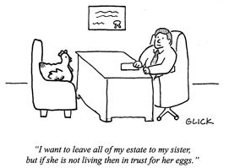

Slide 21
Current Texas Law on Trust Income Characterization
A spouse’s interest in a trust is characterized as community or separate property, generally involving the interest in:
1. ownership of the trust corpus; and
2. ownership of the trust income.
Is it a self-settled trust or 3rd party trust?

Slide 22
CORPUS OF THE TRUST
The character of a spouse’s beneficial interest in a trust depends on the character of the property that makes up the corpus.
A spouse’s beneficial interest is presumptively community property, and standard methods to rebut apply. See Tex. Fam. Code 3.003(a).
Increase in value of undistributed trust retain character of corpus. Dickinson v. Dickinson, 324 S.W.3d 653, 659 (Tex.App.-Fort Worth 2010, no pet.).
Distribution of trust corpus to spouse retains character of corpus.

Slide 23
Income from a 3rd Party Trust
Distributed Income
The characterization of distributed income depends on whether the spouse has a beneficial interest in the corpus of the trust – trust instrument gives a right, even if future right, to control all or a part of the corpus. NOTE: In Texas, income for separate property is generally community.
Interest in Corpus
Income distributed to spouse with beneficial interest in the corpus is community property.
BUT, several courts have a held a more narrow approach and require a present possessory interest in the corpus before the income can be considered community property.
Sharma v. Routh held that a spouse who has interest in the corpus only if he determined that the distributions were necessary to maintain his health and standard of living, did not have a present possessory interest.
No Interest in Corpus
No beneficial interest in the corpus, income characterized as separate property
Recall, if a spouse has no ownership in the corpus of the trust, the corpus is neither separate or community property and therefore a gift from a 3rd party.

Slide 24
Income from a 3rd Party Trust
Undistributed Income
Interest in Corpus – depends on if mandatory or discretionary trust agreement
Mandatory: undistributed income is community property.
Discretionary: undistributed income is separate property.
Even if beneficiary spouse was the sole beneficiary of corpus.
No Interest in Corpus – Undistributed income is separate property.

Slide 25
Income from a Self Settled Trust
Distributed Income
Generally, income generated or distributed during marriage would be community property, regardless of whether the spouse retained a beneficiary interest in the corpus.
Otherwise, characterizing as separate property would circumvent established methods and constitutionality issues by changing community property to separate property just by putting it in a trust.
Undistributed Income
If no interest in corpus: no cases have specifically addressed
If interest in corpus it depends on mandatory or discretionary distribution
Mandatory – community property
Discretionary – there is conflicting case law on the characterization, but presumably character of the corpus (Fort Worth – SP/ Dallas – CP)

Slide 26
Donor Intent
Courts will often look at the language of the trust instrument to determine the express intent of the grantor to determine the characterization of the distributions.
The Fifth Circuit has held that a trust agreement must, “in the most precise and definite way” make any desire to alter the general rule that income for separate property is community property. See Commissioner of Internal Revenue v. Porter, 148 F.2d 566, 568 (5th Cir. 1945).

Slide 27
Form Provisions Addressing Donor Intent

Slide 28
4. “Descendants” and Modern Concepts of Family

Slide 29
Possible Inadvertent Exclusion from “Traditional” Definitions
Children of Same-Sex Couples
Children Born via Surrogate – Exclusion from Genetic Mother’s Estate
Children Given up for adoption
Adult Adoption
Step-Child Adoption

Slide 30
Sample Drafting
A reference to the “descendants” of a person includes in general the person's legitimate children and more remote legitimate, lineal descendants who are living at the time such descendants must be ascertained in order to give effect to such reference. Such descendants shall include (i) any blood descendant and (ii) any person adopted into the line of descent (and such adopted person's own descendants) if, but only if, such person was adopted prior to attaining his or her majority by formal adoption proceedings in a court of record. Subject to the foregoing, whenever a distribution under this Will is to be made to the "descendants, per stirpes" of any person, the property to be distributed shall be divided into as many equal shares as there are then living children of the person and then deceased children of the person who left one or more descendants who are then living. Each living child of the person shall take one of such shares, and the share of each deceased child shall be divided among such deceased child's then living descendants, per stirpes, in the same manner.

Slide 31
Additional Drafting Examples:
Subject to the initial definitions contained on the first page of this trust instrument, references in this trust instrument to "descendant" or "descendants" mean lawful lineal blood descendants of the first, second or any other degree of the ancestor designated; provided, however, that such references shall include, with respect to any provision of this trust instrument, descendants who have been conceived at any specific point in time relevant to such provision and who thereafter survive birth; and provided further that an adopted child and such adopted child’s lawful lineal descendants by blood or adoption shall be considered under this trust instrument as lawful lineal blood descendants of the adopting parent or parents and of anyone who is by blood or adoption a lineal ancestor of the adopting parent or of either of the adopting parents.

Slide 32
Additional Drafting Examples:
Definition of "Child", "Issue" and "Heirs". Subject to the provisions of Subparagraph 1.2 hereof, the term "child" or "children" shall refer only to legitimate sons and daughters of the person in question. Subject to the provisions of Subparagraph 1.2 hereof, the term "issue" shall refer only to legitimate lineal descendants of the first, second or any other degree of the person in question. A child or issue of the person in question shall be deemed to be "legitimate" if such child or issue was either: (i) born or conceived prior to or during a legal, ceremonial marriage of the parents of such person; (ii) born to such person, if such person is a female; (iii) voluntarily or involuntarily legitimated by such person while under the age of eighteen (18) years by a court decree entered prior to the death of such person; or (iv) acknowledged while under the age of eighteen (18) years by such person in a statement of paternity as provided in the Texas Family Code, or a like statement properly executed in another jurisdiction; provided that, notwithstanding the foregoing provisions of this sentence, a child of a person shall not be deemed to be "legitimate" if such child has been legally adopted by another individual of the same gender as is the person in question, unless such child is specifically named herein. The term "heirs" shall refer to those persons who would inherit the property in question from the person in question, assuming that the person in question had died intestate owning such property under the Texas laws of descent and distribution in effect at the time of such person's death, and when such term is used, the shares and proportions of taking shall be determined by said laws. The foregoing provisions notwithstanding, the terms defined in this Subparagraph shall not refer to those who are adopted or to step-children.

Slide 33
Drafting Examples:
Descendants; Descendants, Per Stirpes. Except as otherwise expressly provided
in Paragraph 1 of this Will with respect to my descendants, any reference in this Will to the "descendants" of a person shall mean (i) such person's legitimate children, and (ii) the legitimate descendants of such legitimate children. A posthumous legitimate child shall be considered as living at the death of his or her parent if such child is born within ten (10) months of the death of such parent. Subject to the foregoing, whenever a distribution under this Will is to be made to the "descendants, per stirpes" of any person, the property to be distributed shall be divided into as many equal shares as there are then living legitimate children of the person and then deceased legitimate children of the person who left one or more legitimate descendants who are then living. Each living legitimate child of the person shall take one of such shares, and the share of each deceased legitimate child shall be divided among such deceased legitimate child's then living legitimate descendants, per stirpes, in the same manner.

Slide 34
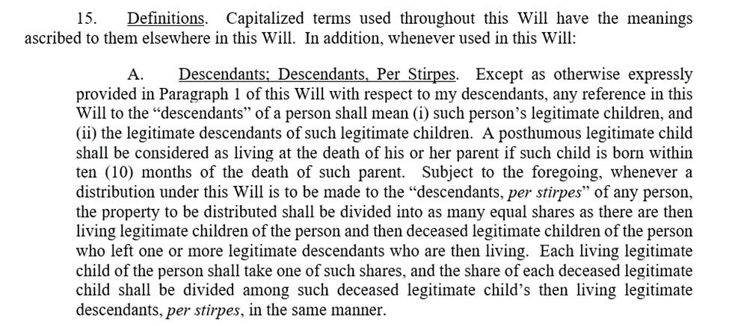
Drafting Examples: Gray Reed

Slide 35
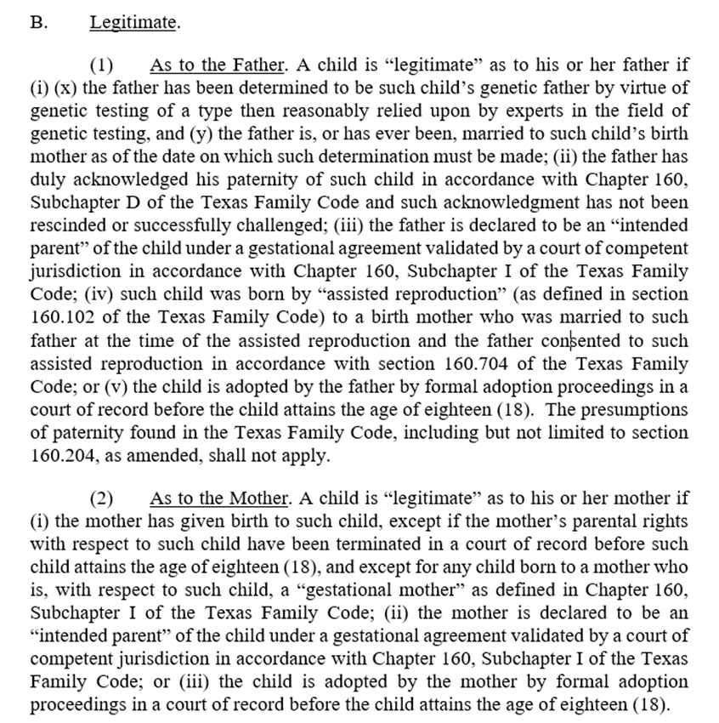
Drafting Examples: Gray Reed

Slide 36
Drafting Examples: Gray Reed

Slide 37
Miscellaneous Issues Involving Entities

Slide 38
Issues from Formation of Entities During Marriage
Even if one spouse is careful to maintain clear and convincing evidence of the source of funding of the acquisition of an interest in an entity during marriage, other issues can arise.
Tracing the funds used to capitalize the entity during the marriage.
Express agreement from lender to look at separate credit of spouse
Utilize corporate lawyer or expert to ensure clear and convincing evidence
Also, assuming there is no pre or post marital agreement altering the outcome of the characterization of distributions from an entity formed during marriage, the contribution of assets that might have otherwise produced separate property income during marriage (such as oil and gas assets) can convert what would have been separate property income to community property income.
See Marshall v. Marshall, 735 S.W.2d 587 (Tex. App.—Dallas 1987, writ ref’d n.r.e.).
See also . . .

Slide 39
Do Single-Member LLCs Protect Members from Creditors?
Heckert v. Heckert – 2020 WL 2608338
In this case, the divorcing husband, Clyde formed both an LP and a single member LLC (to serve as GP) after the parties' divorce but while his ex-wife had a suit for personal injury pending against him. Husband owned all the membership interests in the GP and was the sole LP. Ex-wife won a judgment against him and later contended that his interests in the entities were susceptible to turnover. Husband responded that the interests were not subject to turn over because of Section 101.112 and 153.256 of the TBOC that provide that a charging order is the exclusive remedy by which a judgment creditor of an LP or LLC may satisfy its judgment.
Section 101.112 provides as follows:
On application by a judgment creditor of a member of a limited liability company or of any other owner of a membership interest in a limited liability company, a court having jurisdiction may charge the membership interest of the judgment debtor to satisfy the judgment.
If a court charges a membership interest with payment of a judgment as provided by Subsection (a), the judgment creditor has only the right to receive any distribution to which the judgment debtor would otherwise be entitled in respect of the membership interest.

Slide 40
Do Single-Member LLCs Protect Members from Creditors?
A charging order constitutes a lien on the judgment debtor's membership interest. The charging order lien may not be foreclosed on under this code or any other law.
The entry of a charging order is the exclusive remedy by which a judgment creditor of a member or of any other owner of a membership interest may satisfy a judgment out of the judgment debtor's membership interest. (emphasis added).
This section may not be construed to deprive a member of a limited liability company or any other owner of a membership interest in a limited liability company of the benefit of any exemption laws applicable to the membership interest of the member or owner.
A creditor of a member or of any other owner of a membership interest does not have the right to obtain possession of, or otherwise exercise legal or equitable remedies with respect to, the property of the limited liability company.

Slide 41
Do Single-Member LLCs Protect Members from Creditors?
Section 153.256 which applies to LP, is similar to Section 101.112. Thus, for both LPs and LLCs, Texas statutory law provides that a charging order is generally the exclusive remedy by which to satisfy a judgment out of the judgment debtor's interest in a limited partnership or limited liability company.
Texas courts have held that there are some exceptions to this rule. For example, the Houston (14th) District Court of Appeals has also held that turnover of a member's interest in an LLC was not precluded by § 101.112 "when the judgment creditor seeking the membership interest is the entity from which the membership interest derives" and the turnover order "involves an explicit award of the membership interest itself from one party to the other as part of the judgment.” Gillet v. ZUPT, LLC, 523 S.W.3d 749, 758 (Tex. App.—Houston [14th Dist.] Feb. 23, 2017, no pet.).

Slide 42
Do Single-Member LLCs Protect Members from Creditors?
The reasoning was that a charging order was developed to prevent a judgment creditor's disruption of an entity's business by forcing an execution sale of the partner's or member's entity interest to satisfy a debt of the individual partner or member. The court found that if there are no other owners, no other party's interest will be disrupted by the turnover of the interests in Heckert.
What does this imply for planning with single member LLCs/LP structures where ultimately there are no other interests involved?

Slide 43
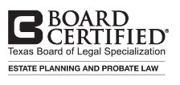
ABOUT US
CONTACT: Glen T. Eichelberger geichelberger@grayreed.com 713.986.7154 Houston, Texas
Focuses on all aspects of trust, estate and philanthropic planning and administration for individuals and families. Advises clients on the most effective ways to minimize estate, gift and generation-skipping transfer taxes, as well as the implementation and administration of complex estate planning structures, including charitable planning and counseling family foundations and other non-profit organizations on a variety of ongoing entity governance matters.
EDUCATION:
J.D., University of Houston Law Center
M.B.A., Baylor University Hankamer School of Business
B.B.A., Accounting, Baylor University
Licensed C.P.A.
GLEN T. EICHELBERGER
Partner Trusts & Estates Department Chair

Slide 44
ABOUT US
CONTACT: Amy C. Allen aallen@grayreed.com 713.986.7234 Houston, Texas
Helps clients throughout the Gulf Coast area to resolve complex, emotionally-charged family disputes, particularly when difficult property issues are involved or they need a compassionate advocate to protect the children caught in the middle. Handles the entire range of issues and disputes that clients may face, including divorce, child custody, modifications, enforcement actions, marital property valuation and characterization, premarital agreements, adoptions and other child-related issues. Amy is Board Certified in Family Law by the Texas Board of Legal Specialization..
EDUCATION:
J.D., University of Houston Law Center
B.S., University of Texas at Austin
AMY C. ALLEN
Partner Family Law

