Slide 1

Modern FLP Valuation
The Rise of the Income Approach and the
Nonmarketable Investment Company
Evaluation Method (NICE)
Presentation to the
Houston Business and Estate Planning Council
September 23, 2022

Slide 2
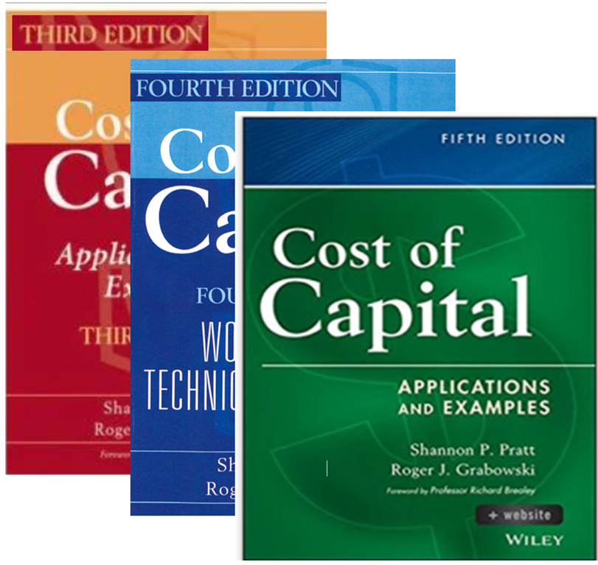
The NICE Method – the Income Approach to Valuing FLPs
Academic Credibility
The NICE Method
is featured in the
leading textbook on
the cost of capital.

Slide 3
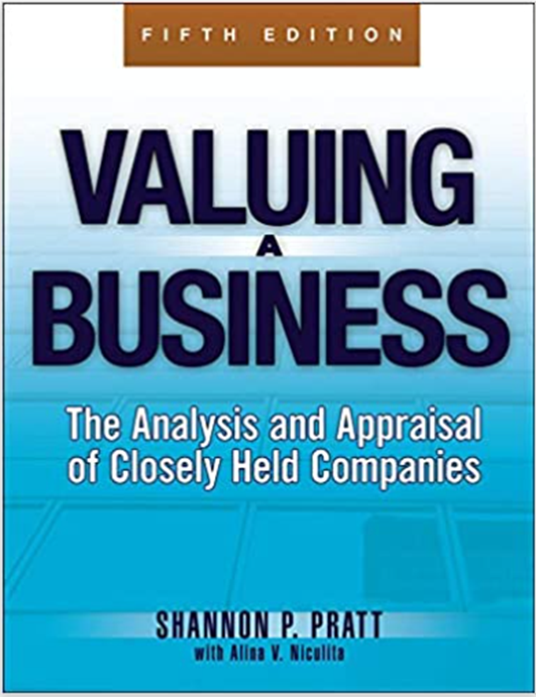
The NICE Method – the Income Approach to Valuing FLPs
Academic Credibility
The NICE Method will
be included in the
forthcoming sixth
edition of
Valuing a Business –
the leading valuation
textbook .

Slide 4
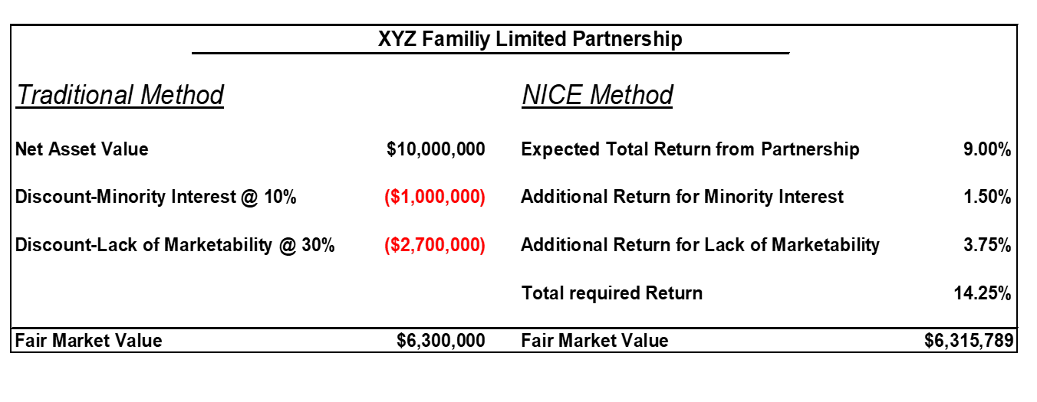
The NICE Method – the Income Approach to Valuing FLPs
Traditional (Market/Asset) Approach v. NICE (Income Approach)

Slide 5
The NICE Method – the Income Approach to Valuing FLPs
The Rise of the Income Approach in FLP Valuation
Elkins v. Commissioner
Estate of Elkins v. Comm'r, 140 T.C. No. 5 (U.S.T.C. Mar. 11, 2013)
Estate of Elkins v. Comm'r, 767 F.3d 443 (5th Cir. 2014)
Fifth Circuit, reversed the prior Tax Court opinion
The Fifth Circuit opinion reinstated the marketability discounts
Undivided interests in art.
The taxpayer’s expert relied on evidence from art experts
  the value of the art on an undivided basis,
  the holding period for the art,
  rates of return data from various art research studies, and anticipated inflation.

Slide 6
The NICE Method – the Income Approach to Valuing FLPs
The Rise of the Income Approach in FLP Valuation
Elkins v. Commissioner (contd.)
The expert was able to determine the rate of return a hypothetical buyer of an undivided interest in art would expect
Assumed 10-year holding period was a reasonable basis on which to assess discounts.
This analysis was applied to 64 works of art.
The range of the discounts determined was from 51.7%-79.7%.
The IRS maintained that no discounts were appropriate.

Slide 7
The NICE Method – the Income Approach to Valuing FLPs
The Rise of the Income Approach in FLP Valuation
Elkins v. Commissioner (contd.)
The IRS did not produce any expert testimony.
The Tax Court opined that some amount of the taxpayer’s discounting was appropriate but found it to be too high.
Using its own logic, the Court determined a 10% discount.

Slide 8
The NICE Method – the Income Approach to Valuing FLPs
The Rise of the Income Approach in FLP Valuation
Elkins v. Commissioner (contd.)
    The Fifth Circuit ruled that the IRS did not meet its burden of proof since it did
    not produce any valuation evidence.
    However, it also noted that the Tax Court had no basis for its 10% discount.
    The only valuation opinion left to be considered was that of the taxpayer
    Not just a win by default for the taxpayer’s expert
    The Fifth Circuit further stated: “…We conclude that the discounts determined by the Estate’s experts are not just the only ones proved in court; they are eminently correct.”

Slide 9
The NICE Method – the Income Approach to Valuing FLPs
The Rise of the Income Approach in FLP Valuation
Grieve v. Commissioner
Dealt with the valuation of a large majority interest (99.8%) with no voting rights in a holding entity.
There were two separate entities involved but the valuation facts were nearly identical.
Both held primarily public stock and cash.
The taxpayer’s initial expert, whose valuation was used for filing purposes (but not at trial), used a relatively standard restricted stock study analysis to determine the lack-of-marketability discount, concluding on discounts of 25% for both entities.

Slide 10
The NICE Method – the Income Approach to Valuing FLPs
The Rise of the Income Approach in FLP Valuation
Grieve v. Commissioner (contd.)
The taxpayer’s legal team brought Stout Risius Ross in as a second valuation expert for purposes of the trial.
Also did a similar closed-end fund/restricted stock approach- the “Traditional” approach.
Introduced an Income Approach- the Non-marketable investment company evaluation method (NICE)
Our value which was slightly lower than that of the original expert.

Slide 11
The NICE Method – the Income Approach to Valuing FLPs
The Rise of the Income Approach in FLP Valuation
Grieve v. Commissioner (contd.)
The IRS’ expert used a novel valuation approach. Reasoned that buyer could alternatively approach the 0.2% voting interest holder and consolidate their ownership to 100% and eradicate the discount
The IRS expert concluded a discount for the 99.8% interest of about 1.5%
The Tax Court rejected the IRS expert’s approach:
“[w]e do not engage in imaginary scenarios as to who the purchaser might be, citing Estate of Giustina v. Commissioner, 586 F. App’x 417, 418 (9th Cir. 2014).
The Court decided to adopt the valuation opinions of the original expert. Its conclusions were used for the filing and pre-trial stipulations and Stout report’s values were very close (slightly lower).

Slide 12
The NICE Method – the Income Approach to Valuing FLPs
The Rise of the Income Approach in FLP Valuation
Grieve v. Commissioner (contd.)
First use of the NICE method in Tax Court
The Court did not adopt it but it was not critical of it.

Slide 13
The NICE Method – the Income Approach to Valuing FLPs
Grieve v. Commissioner – the “silent” endorsement
The Court:
“…we conclude that the market approach is a reasonable method.”
The court did not say the market approach was the only or even the most reasonable approach but that it was merely a reasonable approach.
The only alternative discussed in this case was the NICE Method.

Slide 14
Grieve v. Commissioner – Support from the IRS Expert
The Court: “…do you have any concerns about the NICE method in general?”
IRS Valuation Expert: “Oh, I could probably make some
academic arguments that would interest nobody in the room
but me and Mr. Frazier. But in a general sense, I think
it gets it at the correct points. “
THE COURT: “So you think it's a reasonable approach overall?”
IRS Valuation Expert: “Overall –”
THE COURT: “Okay.”

Slide 15
The NICE Method – the Income Approach to Valuing FLPs
The Rise of the Income Approach in FLP Valuation
Nelson v. Commissioner
The taxpayer’s expert looked to several studies on the sales of restricted stock with a two-year holding period and private, pre-initial-public-offering (IPO) stock.
The IRS’ valuation expert compiled a range of discounts by using:
quantitative models that looked at the role of liquidity premiums in calculating the value of a forgone put option on the basis of the Black-Scholes model and considering hypothetical rates of return.
He also examined several studies on the sales of restricted stock and pre-IPO stock, but these studies involved more recent data.

Slide 16
The NICE Method – the Income Approach to Valuing FLPs
The Rise of the Income Approach in FLP Valuation
Nelson v. Commissioner (contd.)
Tax Court concluded that the IRS expert’s analysis was more thorough
The IRS expert considered a larger range of data (quantitative models and studies with more recent data)

Slide 17
The NICE Method – the Income Approach to Valuing FLPs
The Identification of the Problem-Why We Need the Income Approach
Nelson v. Commissioner (contd.)
“[Taxpayer’s expert’s] analysis depends on several studies on the sale of restricted stock and private, pre-IPO stock that have been brought to the attention of this Court before... And in those cases we have repeatedly disregarded experts' conclusions as to discounts for long-term stock holdings when based on these studies. See Estate of Bailey v. Commissioner, 2002 WL 1315805, at *10; Furman v. Commissioner...Accordingly, we will disregard [Taxpayer’s expert’s] conclusions as to a discount... which was based on these studies.”

Slide 18
The NICE Method – the Income Approach to Valuing FLPs
Confusion about the holding period
Furman v. Commissioner, T.C. Memo. 1998-157
“We find petitioners' reliance on the restricted stock studies to be misplaced, since those studies analyzed only restricted stock that had a holding period of 2 years. Inasmuch as we expect the investment time horizon of an investor in the stock of a closely held corporation like FIC to be long term, we do not believe that marketability concerns rise to the same level as a security with a short-term holding period like restricted stock. In light of the foregoing, we find no persuasive evidence in the record to support our reliance on the restricted stock studies in determining an appropriate marketability discount.”

Slide 19
The NICE Method – the Income Approach to Valuing FLPs
Confusion about the holding period
Bailey v. Commissioner
“The restricted stock studies that [petitioner’s expert]relied upon analyzed stocks that had a holding period of 2 years or less. The record contains no evidence,
however, to support an assumption that an investor in C&L Bailey would likely have such a short-term investment horizon.
To the contrary, the evidence in the record strongly suggests that since the inception of C&L Bailey, there has been no trading of its shares, suggesting that the hypothetical willing buyer who is representative of prospective investors in C&L Bailey might well have a longer investment horizon than the investors of the restricted stocks analyzed in the studies.”

Slide 20


The NICE Method – the Income Approach to Valuing FLPs
Components of Value: Returns, Risk (Volatility) and Time (Holding Period)
____
(1+r)^{n}
D = the expected future distributions
r = the annual cost or rent of money described as the
required ROR or “discount rate” -RISK
n = the number of years from the present to the expected
future realization of funds through the sale of the asset
HOLDING PERIOD

Slide 21
The NICE Method – the Income Approach to Valuing FLPs
The Rise of the Income Approach in FLP Valuation

Slide 22
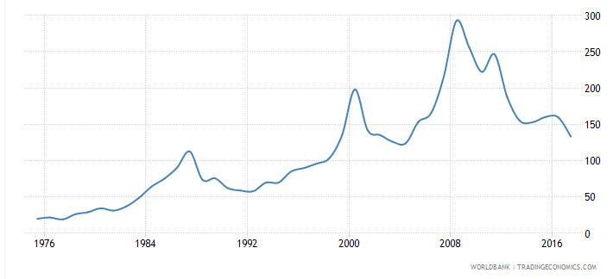
The NICE Method – the Income Approach to Valuing FLPs
The Rise of the Income Approach in FLP Valuation
Ratio of the value of total shares traded to average real market capitalization

Slide 23
The NICE Method – the Income Approach to Valuing FLPs
Impact of Time and Volatility (Risk) on Value

Slide 24
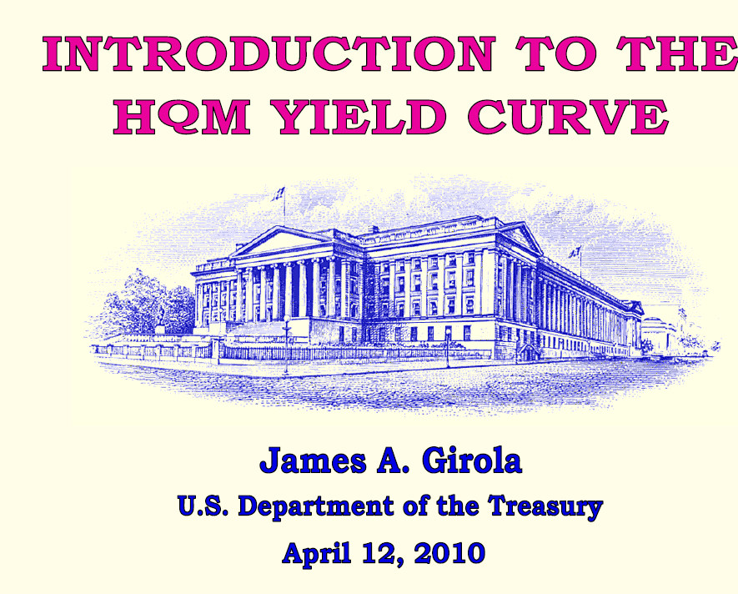
Underpinnings of the Income Approach

Slide 25

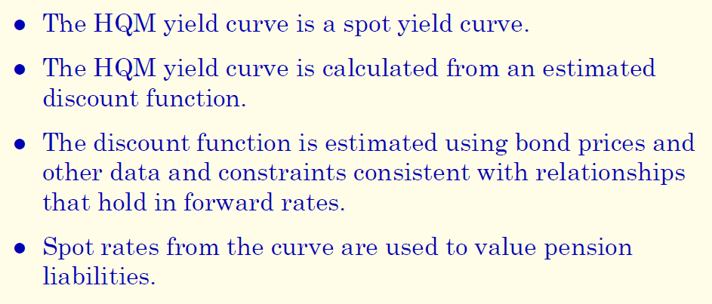
Underpinnings of the Income Approach

Slide 26
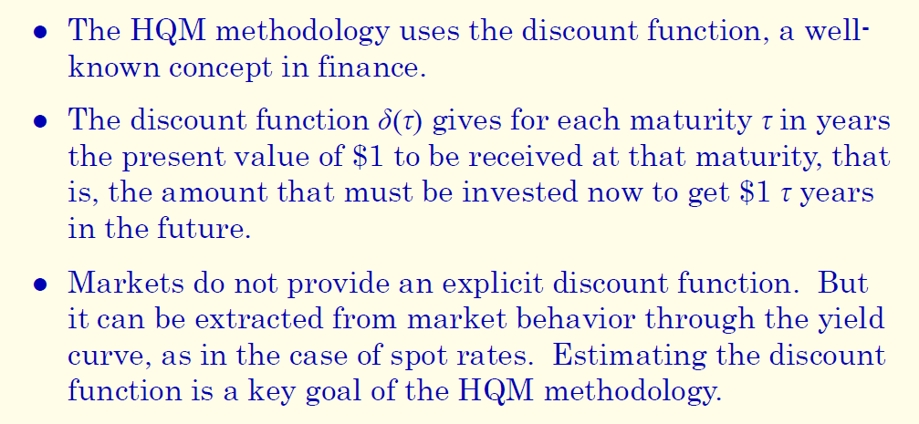
Underpinnings of the Income Approach

Slide 27
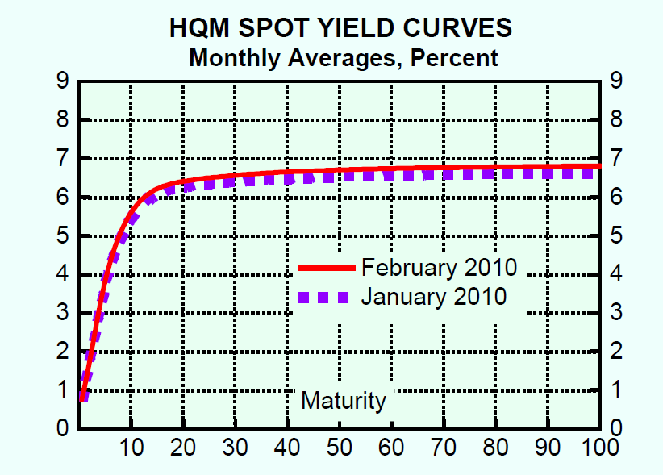
Underpinnings of the Income Approach

Slide 28
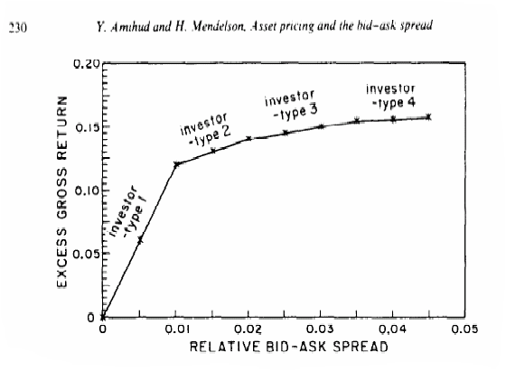
Amihud and Mendelson - NYU

Slide 29
The NICE Method – the Income Approach to Valuing FLPs
Illiquidity- Increases at a Decreasing Rate

Slide 30
The NICE Method – the Income Approach to Valuing FLPs
Fair Market Value premise
Fair Market Value is that one PRICE that best fits the parameters of the BUYER-SELLER expectations.
We can estimate the expected returns of the FLP
Range of the holding period is a lengthy uncertainty:
FMV is the one price that, for all years of the FLP’s duration, provides a Rate of Return (ROR)that is the best possible compromise between the buyer’s and seller’s objectives in the light of the reality of the marketplace.

Slide 31
The NICE Method – the Income Approach to Valuing FLPs
Simplified Example – FLP holding only Large Cap Common Stock

Slide 32
The NICE Method – the Income Approach to Valuing FLPs
RROR Components

Slide 33
The NICE Method – the Income Approach to Valuing FLPs
Incremental Rate of Return for Lack of Control (“IROC”)

Slide 34
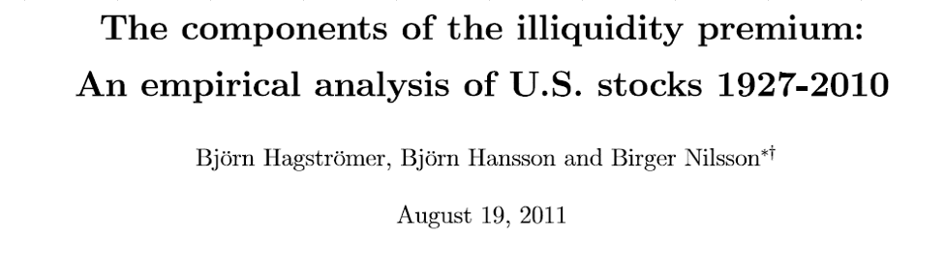
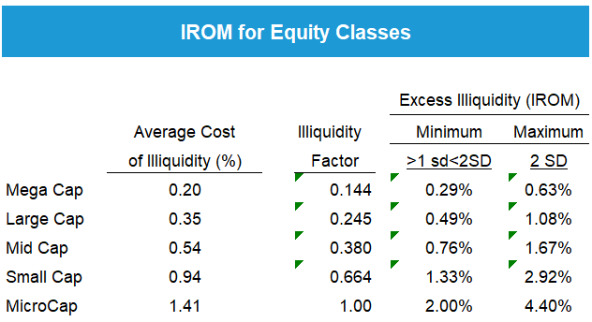
IROM theory

Slide 35
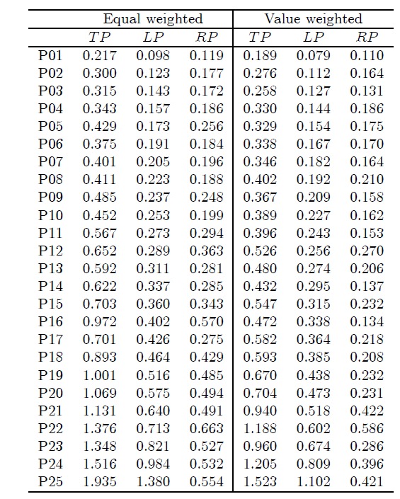
HHN Study Illiquidity Cost by Size-ranked Portfolios

Slide 36
HHN Study Illiquidity Cost by Size-ranked Portfolios

Slide 37
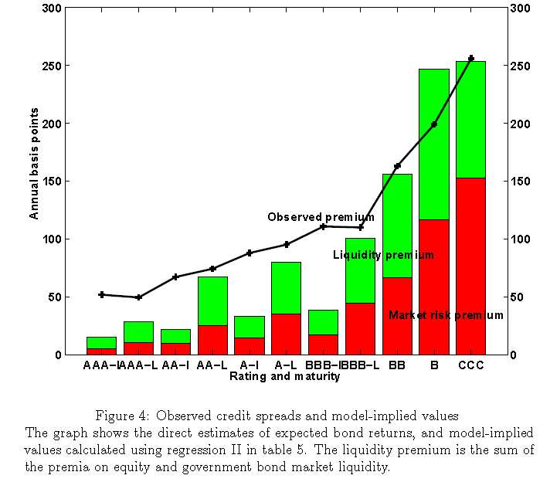

IROM - Bonds
Liquidity Risk Premia in Corporate Bond and Equity Markets- de Jong and Driessen

Slide 38
IROM- Corporate Bonds

Slide 39
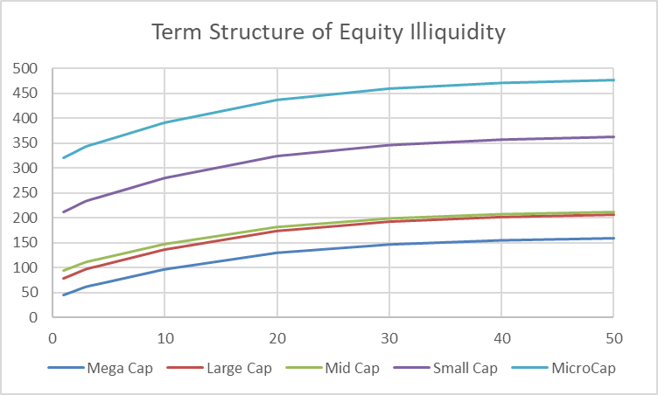

Slide 40
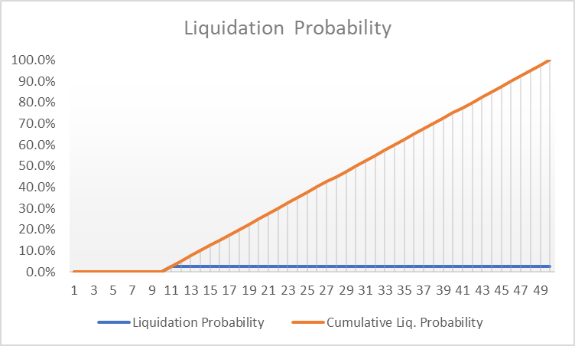
The NICE Method – the Income Approach to Valuing FLPs

Slide 41
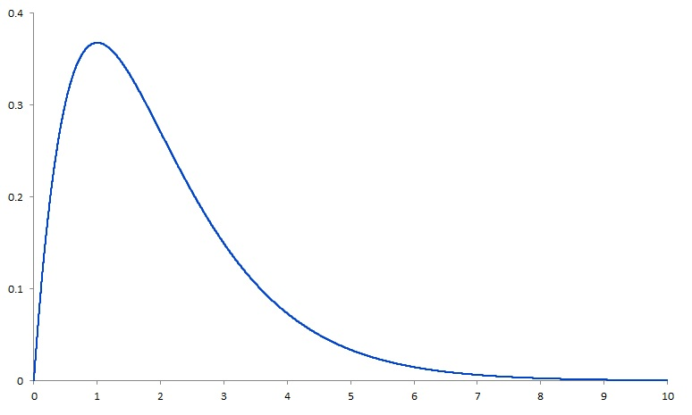
The NICE Method – the Income Approach to Valuing FLPs
Front end loaded (right skewed) Probability Distribution

Slide 42
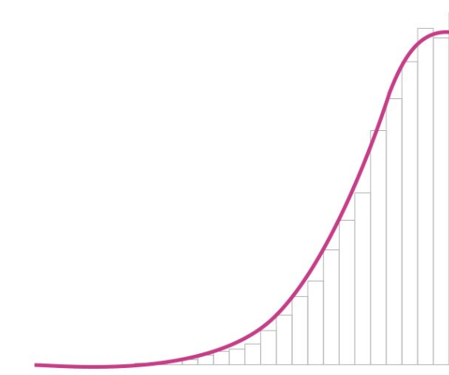
The NICE Method – the Income Approach to Valuing FLPs
Back end loaded (left-skewed) Probability Distribution

Slide 43
The NICE Method – the Income Approach to Valuing FLPs
NICE METHOD MODEL - ROR

Slide 44
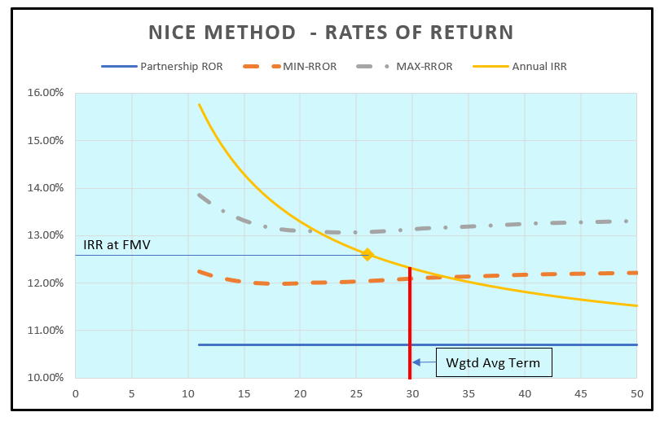
The NICE Method – the Income Approach to Valuing FLPs
Curve of Best Fit - Described by Fair Market Value

Slide 45
The NICE Method – the Income Approach to Valuing FLPs
Criticisms of the NICE Method
The NICE Method is too Complicated
I make no apologies
It is certainly more difficult than applying discounts
It is less complicated than determining WACC by CAPM
Highly compensated appraisers should be expected to use state of the art methodologies rather taking the path of least resistance.

Slide 46
The NICE Method – the Income Approach to Valuing FLPs
Criticisms of the NICE Method
The NICE Method is a “Black Box”
Previously, it was no more a black box than the Black Scholes Option Pricing Model.
Today, is totally open and transparent.
      It is an Excel based model
      No cells are protected are locked
      All formulas are visible
      The model is provided at no charge

Slide 47
The NICE Method – the Income Approach to Valuing FLPs
Criticisms of the NICE Method
The IRS Will Not Accept Estimated Termination Dates
The IRS never accepted the deductibility of built-in capital gains taxes, tax affecting or the disregarding of family attribution until challenged.
Grieve-Despite IRS expert criticism, the Court paid no heed.
Elkins -10 year holding period accepted by 5th Circuit
LeFrak v. Commissioner, 66 T.C.M. 1297 (U.S.T.C. 1993)
Richmond v. Commissioner, T.C. Memo. 2014-26
S corporation 5-10 year holding period for built-in gain avoidance

Slide 48
The NICE Method – the Income Approach to Valuing FLPs
Criticisms of the NICE Method
A 50 Year Holding Period is Too Long
The NICE max holding period is 50 years- but the “holding period” is a range—usually 10-50 years.
The weighted average holding period is 30 years.
  0% probability years 1-11
  67% probability of liquidation by year 37
2/3 probability liquidation before year 37
In Grieve, a 17.5 year weighted average holding period was found.

Slide 49
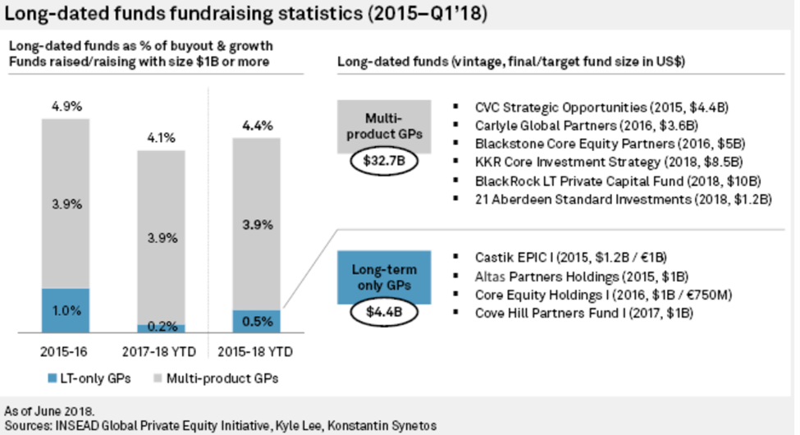
The NICE Method – the Income Approach to Valuing FLPs
Criticisms of the NICE Method
Examples of Very Long Term Investments

Slide 50
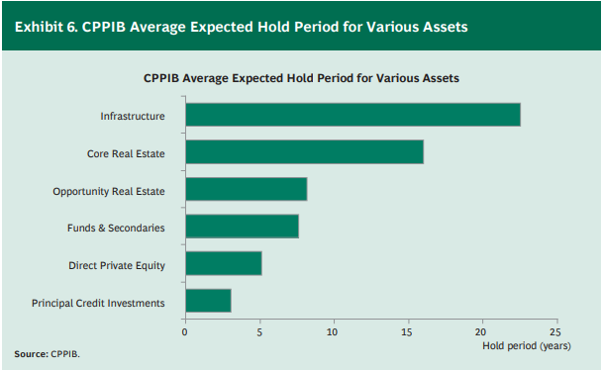
The NICE Method – the Income Approach to Valuing FLPs
Criticisms of the NICE Method
Examples of Very Long Term Investments
The Rise of Alternative Assets and Long-Term Investing -Boston Consulting Group. March, 2017.

Slide 51
The NICE Method – the Income Approach to Valuing FLPs
Criticisms of the NICE Method
Examples of Very Long Term Investments
Estate of Jones v. Comm'r T.C. Memo. 2019-101 (U.S.T.C. Aug. 19, 2019)
“SJTC practiced sustained yield harvesting, which means it limited its harvest
to the growth of its tree farms. In doing so SJTC used a model that projects
out 50 years, assuming a 50-year growth term, to determine its
annual yield each year.”

Slide 52

BIOGRAPHY
Will Frazier, ASA
I have over 40 years of experience in the field of valuation, investment banking, mergers & acquisitions, and litigation advisory services. In the past twenty years, I have testified in person or through affidavit over twenty times in many different courts, including U.S. Tax Court, Federal Bankruptcy Court, U.S. District Court, various state courts, and probate court. Notable Tax Court cases I have testified in are: Grieve, Steinberg, Hendricks, Jelke, McCord, Dunn and DiSanto.
I have been a senior member of the American Society of Appraisers (ASA) since 1987. I have served on various boards and committees of the ASA over the years, including chair of the Government Relations Committee, Business Valuation Committee (treasurer and secretary), Standards Sub-committee of Business Valuations Committee, and Education Foundation. I currently serve on the Standards Sub-committee. I was also the head of the Tax Reform Task Force of the ASA, a body created to offer guidance to members of the business valuation profession with respect to the Tax Cuts and Jobs Act. I also served on the IRS Advisory Council (IRSAC) from 2009-2011. I am the current ASA Government Relations Committee liaison to the Business Valuation Committee.
214-909-6144
will@whfrazier.com
www.whfrazier.com

