Slide 1
Visa Options for
Domestic Employees
Judy J. Lee, Partner
Kari K. Blackman, Senior Attorney

Slide 2

Session Highlights
Overview of U.S. Immigration
Common Immigration Documentation
New Developments Impacting Immigration
Temporary Work Visas for Domestic Employees
Permanent Residency Options
Question & Answer

Slide 3

U.S. Population by Immigration Status
U.S. Citizens - over 300 million
All others – around 27 million
  Who are the others?

Slide 4
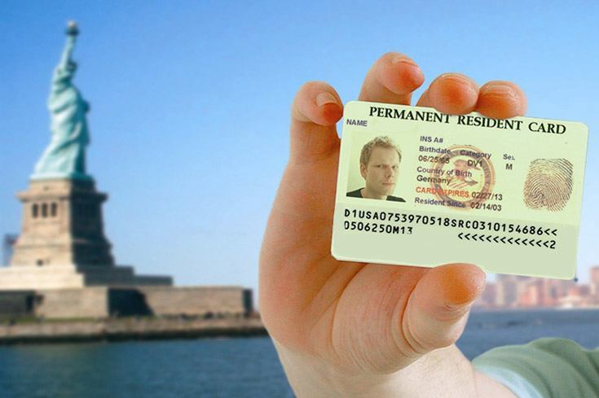
Lawful Permanent Residents
(a.k.a. “Green Card”)
Family based sponsorship
  Spouse, Child, Parent, Sibling (some subject to quotes)
Employment based sponsorship
  Limit 140,000 quota
Asylee or Refugee
  Refugee quota reduced to 30,000
  Over 800,000 asylum applications pending
Other Programs
  Military service, Cuban Adjustment Act, Diversity Lottery, etc.

Slide 5

Temporary Non-Immigrant Visa Status
Alphabet Categories
  A diplomats, B visitors/tourists, E investors, F students, H-1B professional workers, etc., to WT Visa Waiver Tourists
Specific purpose to each category
  Work or Other
Limited, temporary stay
  A few weeks to many years
  Must leave the U.S. when program is over

Slide 6

Other Programs
Provide protection from deportation and some have work permission, but no “status”
DACA (Deferred Action for Childhood Arrivals)
  Young “Dreamers” approximately 800,000
TPS (Temporary Protected Status)
  10 countries, total 300,000 - 2/3 from El Salvador
Other miscellaneous programs

Slide 7

No Status or Program
Illegally entered - EWI
Entered legally but overstayed or violated status
Estimated 12 million in the U.S.
Includes blended families of U.S. citizens, permanent residents, legal and undocumented

Slide 8



Government Agencies Involved
Department of Homeland Security
  US Citizenship & Immigration Services (USCIS) – Services and benefits (family and employment); naturalization; special status programs.
  US Immigration & Customs Enforcement (ICE) – Interior investigations and enforcement, including SEVIS enforcement; smuggling; document fraud; raids.
  US Customs & Border Protection (CBP) – Inspections at ports of entry; Customs functions; border patrol.
Department of State
  Issues visas to enter the US.
Department of Labor
  PERM Labor Certification and H-1B Labor Condition Application (LCA).

Slide 9
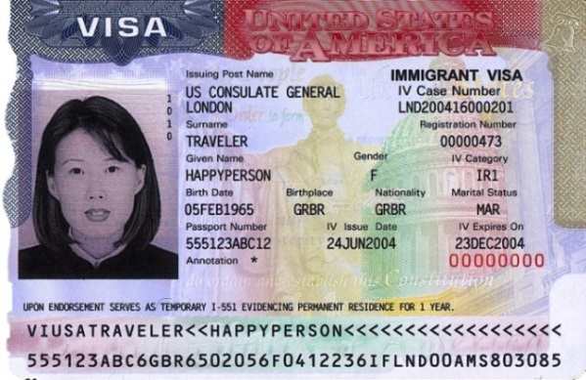
Document: Visa Stamp
The visa reflects:
  The nonimmigrant category
  The validity dates for travel on the visa
  Any additional notes or restrictions
Indicates to the inspecting officer that the applicant, and his or her purpose for entry, have been prescreened
  Does not guarantee admission upon inspection by U.S. Customs & Border Protection
  A “ticket” to apply for admission to the U.S.
  Canadians are exempt and do not require a visa

Slide 10
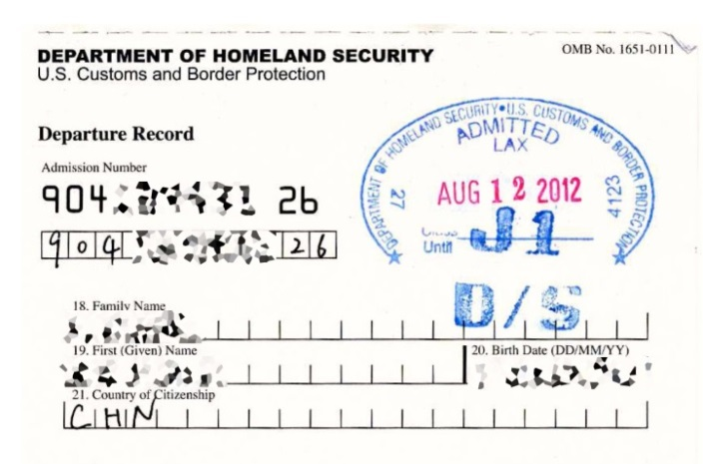
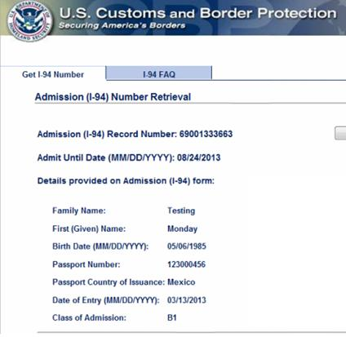
Document: I-94 Arrival/Departure Record
The I-94 controls status and permissible period of stay in the U.S.
CPB will only issue electronic I-94s for air and sea travel, although paper I-94s are still being issued at land border Port of Entry.
Passport or travel documents will be stamped with admission date, visa class, and expiration date.
I-94 records are available on CPB’s website: https://i94.cpb.dhs.gov/I94/#/recent-search
Check I-94 record upon each entry into U.S.

Slide 11
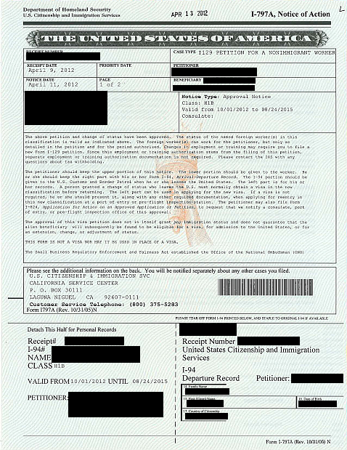
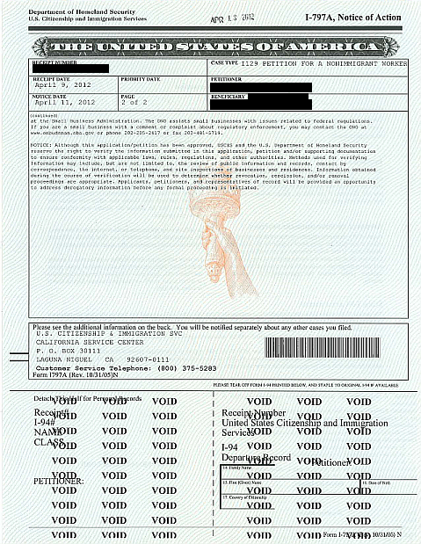
Document: I-94 Arrival/Departure Record
“Change of status” within the U.S.:
Form I-797 approval notice is issued with a new I-94 card attached
New status starts automatically on validity date
Whenever the employee leaves the U.S., a visa stamp in passport must be obtained at a U.S. consulate abroad to return, except:
  Canadian citizens (visa exempt)
  Special rules for travel to Mexico or Canada for less than 30 days

Slide 12
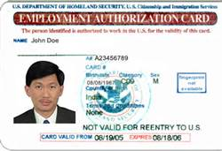
Document: EAD or Work Permit
F-1 Students
Applicant for Adjustment of Status
Dependent Spouses of L-1, E-1, E-2, J-1, H-1B
K-1 Fiancé, Refugees, Asylees, Temporary Protected Status, DACA, etc.

Slide 13
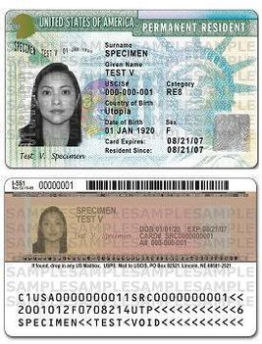
Document: Green Card or Form I-551

Slide 14
Recent Restrictions in Immigration
March 6, 2017: President Trump issued Executive Order Protecting the Nation from Foreign Terrorist Entry. Calls for Department of Homeland Security and Department of State to collect all information required to “rigorously evaluate all grounds of inadmissibility or deportability, or grounds for the denial of other immigration benefits.”
April 18, 2017: President Trump issued Buy American and Hire American Executive Order. “In order to create higher wages and employment rates for workers in the United States, and to protect their economic interests, it shall be the policy of the executive branch to rigorously enforce and administer the laws governing entry into the United States of workers from abroad.”

Slide 15

Practical Impact at DOS/CBP
and on International Travel
Heightened scrutiny and denials of visa applicants at U.S. Department of State (DOS) consular posts, including more delays in visa issuance and more denials
Readjudication of approved visa petitions at U.S. consular posts
Increased screening of travelers by U.S. Customs & Border Protection (CBP) when seeking entry (admission) to U.S.
Search of social media accounts, cell phones, laptops
Travel ban – upheld by U.S. Supreme Court

Slide 16

Practical Impact at DOS/CBP
on Nonimmigrant (Temporary) Petitions
Strict scrutiny in adjudications with spike in issuance of Requests for Evidence (RFE) and Notices of Intent to Deny (NOID)
No longer deference to prior determinations when seeking extensions of status
Increase in denials
More difficult & costly for employers to hire foreign talent

Slide 17

Visa Options for Domestic Employees
Non-immigrant, temporary visa that allows for work authorization while in the U.S.
Green Card sponsorship for a permanent position
Types of positions: cooks, butlers, chauffeurs, housemaids, housekeepers, valets,
nannies/au pairs, gardeners, paid
companions
Generally these are skilled or unskilled workers
  College degree not required

Slide 18
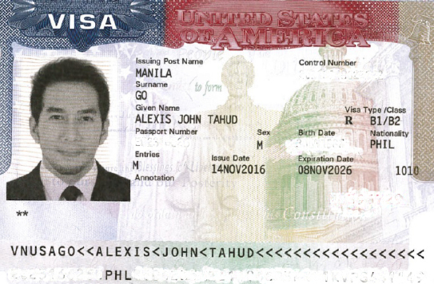
B-1 Non Immigrant Visas for Domestic Employees
9 FAM 402.2-5(D)
Must apply for B-1 Visa at U.S. Consular post abroad.
  “B-1 Domestic Employee” Annotation
Period of Admission: Up to 1 year on I-94
Extensions: Increments of up to 6 months
Must apply with USCIS for an Employment Authorization Document (EAD Card)
  I-765 processing times: 3 – 4 months
  EAD expiration usually matches expiration of B-1 status
  Timing challenge to maintain continuous work authorization

Slide 19
Requirements for the Employer of a B-1
Domestic Employee
U.S. Citizens Residing Abroad on temporary visit to U.S.
U.S. Citizens on Temporary Assignment in U.S.
  Subject to frequent international transfers lasting 2 years or more as a condition of the job (confirmed by employer); and
  Returning to the U.S. for a stay of no more than 6 years.
Non-immigrant visa holders
  B, E, F, H, I, J, M, O, P or Q status
Employer cannot be a Lawful Permanent Resident (Green Card Holder)
Employer cannot be a U.S. citizen living permanently in the U.S.

Slide 20

B-1 Domestic Employee Employment Contract
Must be drafted and signed prior to the employee’s visa interview
Must include the following terms:
  The employer will be the only employer of the domestic employee;
  The employer will provide free room and board and round trip airfare;
  The employee will receive the greater of the minimum or prevailing wage under federal, state, or local law;
  *Employer will give 2 weeks’ notice to terminate, and the employee need not give more than 2 weeks’ notice
  *Contract must also reflect benefits normally required for U.S. domestic workers in the area
  *Applies only to U.S. Citizen Employers

Slide 21

J-1 Au Pair Program
Host Families receive childcare from screened participant
Participant experiences life in America with an opportunity to study
Must use a Dept of State designated Au
Pair Sponsor Organization – 15 sponsors
Texas – GreatAuPair, LLC but any can be
used; compare programs
Duration: 12 months (extensions of 6, 9, or 12 months)
Host family costs – estimated $20,000 including weekly payments, air, program fees, etc.

Slide 22


J-1 Au Pair- Participant Requirements
Proficient in English
Secondary school graduate or equivalent
Between 18-26 years old
Satisfactory completion of a physical
Personal interview in English by Au Pair program representative
Background investigation
  Verification of references and
  personality profile

Slide 23

Host Family Requirements Include:
Pay up to $500 toward required academic coursework;
Provide suitable private room and 3 meals a day for the au pair;
Be US citizens or permanent residents fluent in English;
Pay a weekly minimum stipend;
Give the au pair one complete weekend off each month;
Provide a minimum of two weeks paid vacation in addition to regular weekly/monthly time off;
Include the au pair whenever possible in family meals, outings, holidays, and other events; and
Sign an agreement/contract with the au pair

Slide 24

J-1 Au Pair Program Restrictions
Cannot be placed with a family who has an infant less than three months old (unless a responsible adult is home)
Cannot be placed with children under 2 years old (unless au pair has at least 200 hours infant childcare experience)
Cannot be placed in families with special needs children (unless au pair has special skills/training)
Cannot be placed in homes of relatives

Slide 25


H-2B Temporary Worker Visa:
Permits employers to hire foreign workers to perform temporary (less than one year) work
  One time occurrence
  Peakload need
  Seasonal need
  Intermittent need

Slide 26

H-2B Temporary Worker Visa Requirements
Step 1: Obtain certification from DOL that there are no qualified and willing U.S. workers available for the sponsored position + terms will not adversely impact wages and working conditions
  Place 10-day job order with State
  Place 3-day ad in newspaper of general circulation
  Meet any union requirements
  Summarize recruitment + lawful reasons for rejection
Step 2: File H-2B petition with USCIS
Step 3: Apply for visa at the consulate after USCIS issues approval

Slide 27
EAD Card Holders
F-1 Students
Applicant for Adjustment of Status
Dependent Spouses of L-1, E-1, E-2, J-1, H-1B
K-1 Fiancé, Refugees, Asylees, Temporary Protected Status, DACA, etc.

Slide 28
Permanent Residence Process
Labor Certification
PERM
Immigrant Petition
I-140
Adjustment of Status
I-485
Consular Processing

Slide 29

Step 1: PERM Labor Certification
Objective: Protect U.S. workers
Employer must conduct a detailed recruitment campaign to prove that no qualified, willing, able or available U.S. worker applied
Employer must obtain a formal Prevailing Wage Determination and pay the required wage rate when green card is approved
Other considerations:
  Job position must be “permanent”
  Employer must pay all PERM costs
  Specific to the company, location and
  position
  if these change, a new PERM may be
  required

Slide 30

Step 2: Immigrant Visa Petition
(Form I-140)
Establish that employee meets minimum requirements for position that served as basis for PERM
  Degree and transcripts
  Experience verification letters
  Certification, license, etc.
Prove employer can pay offered salary
Must be filed within 180 days of PERM approval or PERM expires
Premium processing is currently available
Priority date “attaches” to the foreign national upon I-140 approval

Slide 31
October 2018 Visa Bulletin
Employment-Based Preference |  | All Chargeability Areas Except Those Listed | CHINA-Mainland Born | INDIA | MEXICO | PHILIPPINES
1st | Filing Cut-off Date | 01JUN18 | 01OCT17 | 01OCT17 | 01JUN18 | 01JUN18
 | Final Action Cut-Off Date | 01APR17 | 01JUN16 | 01JUN16 | 01APR17 | 01APR17
2nd | Filing Cut-off Date | C | 15JUN15 | 27MAY09 | C | C
 | Final Action Cut-off Date | C | 01APR15 | 26MAR09 | C | C
3rd | Filing Cut-off Date | C | 08AUG15 | 01OCT09 | C | 01JUL17
 | Final Action Cut-off Date | C | 01JUN15 | 01JAN09 | C | 01JUN17
Other Workers | Filing cut-off Date | C | 01JUN18 | 01OCT09 | C | 01JUN17
 | Final Action Cut-off Date | C | 01MAY07 | 01JAN09 | C | 01JUN17

Slide 32

Step 3: Adjustment of Status
or Consular Processing
Purpose: Show employee and dependent family members are admissible to U.S.
No communicable disease, such as tuberculosis or drug addiction (Medical exam required)
No harmful, dangerous mental impairment
No criminal convictions (Biometrics required)
No past US immigration violations fraud/
misrepresentation/ deportation
No claim to being a US citizen
No membership in terrorist or communist organization
In-person interview with USCIS or DOS Officer required

Slide 33
Success! – Green Card

Slide 34

Questions
Judy J. Lee
Partner
Foster LLP
jlee@FosterGlobal.com
713.335.3971
Kari Konikowski Blackman
Senior Attorney
Foster LLP
kkblackman@FosterGlobal.com
713.335.3918

